Slide 1
Al-Farabi Kazakh National University
Higher School of Medicine
Translation of genetic information
Lecturer: PhD Pinsky Ilya Vladimirovich

Slide 2
LEARNING OUTCOMES
As a result of the lesson you will be able to:
explain the ribosome cycle and fidelity of translation;
define the genetic code, tRNA, mRNA, codon, anticodon;
describe the structure of tRNA and the mechanism of its charging;
explain the scanning model of translation;
explain the mechanism of translation and its phases;
describe the structure of ribosomes and polysomes.

Slide 3
Literature
Alberts et al., pp. 333-362;
Russell, pp. 102-130;
Weaver, pp. 522-601.

Slide 4
Translation
DNA/RNA
Protein
Adenine
Cytosine
Guanine
Thymine/Uracil
Alanine Arginine
Asparagine Aspartate Cysteine Glutamine
Glutamate Glycine
Histidine Isoleucine
Leucine Lysine
Methionine Phenylalanine
Proline Serine
Threonine Tyrosine
Tryptophan Valine
Notes:
4

Slide 5
One-letter code
Two-letter code
A
G
C
T/U
AA CA GA UA
AG CG GG UG
AC CC GC UC
AU CU GU UU

Slide 6
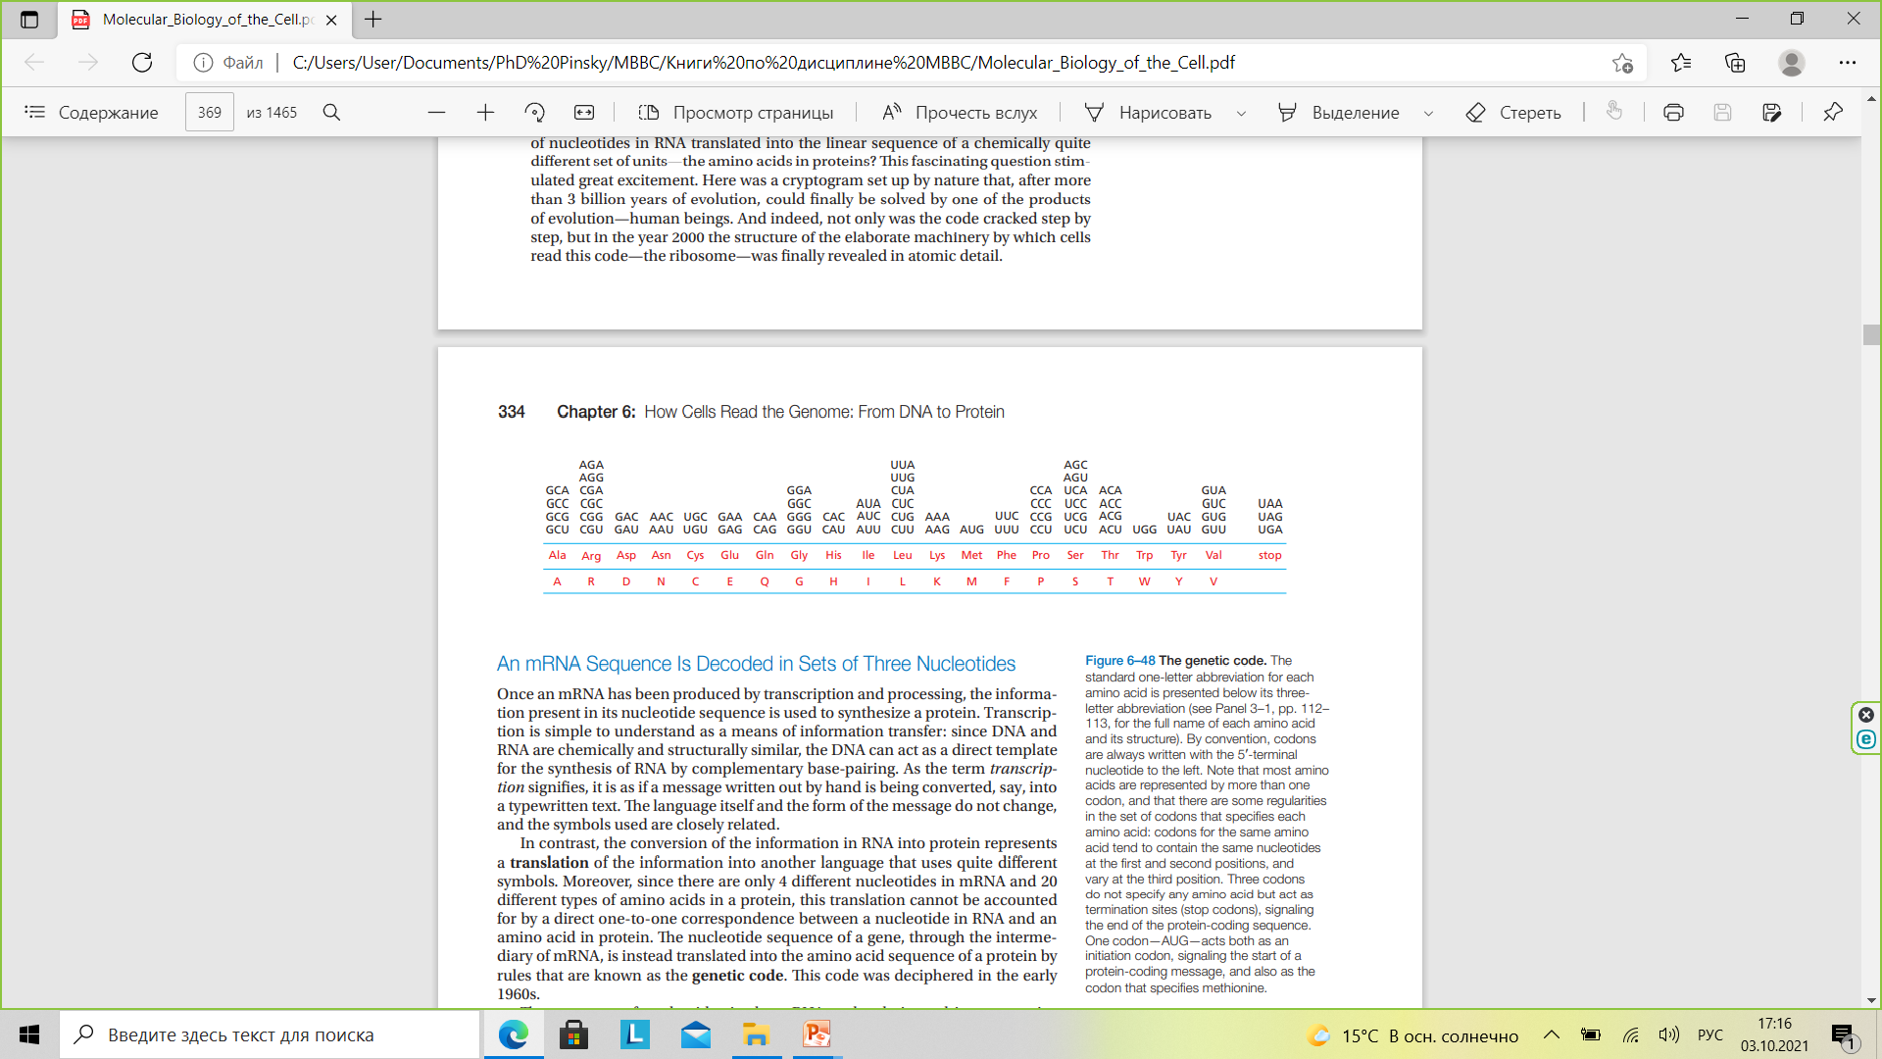

Slide 7
Bases in DNA/RNA form triplet code
 |  | Second Base
 |  | U |  | C |  | A |  | G
First base | U | UUU | Phe (F) | UCU | Ser (S) | UAU | Tyr (Y) | UGU | Cys (C) | U | Third base
 |  | UUC |  | UCC |  | UAC |  | UGC |  | C
 |  | UUA | Leu (L) | UCA |  | UAA | Stop | UGA | Stop | A
 |  | UUG |  | UCG |  | UAG | Stop | UGG | Trp (W) | G
 | C | CUU | Leu (L) | CCU | Pro (P) | CAU | His (H) | CGU | Arg (R) | U
 |  | CUC |  | CCC |  | CAC |  | CGC |  | C
 |  | CUA |  | CCA |  | CAA | Gln (Q) | CGA |  | A
 |  | CUG |  | CCG |  | CAG |  | CGG |  | G
 | A | AUU | Ile (I) | ACU | Thr (T) | AAU | Asn (N) | AGU | Ser (S) | U
 |  | AUC |  | ACC |  | AAC |  | AGC |  | C
 |  | AUA |  | ACA |  | AAA | Lys (K) | AGA | Arg (R) | A
 |  | AUG | Met (M) Start | ACG |  | AAG |  | AGG |  | G
 | G | GUU | Val (V) | GCU | Ala (A) | GAU | Asp (D) | GGU | Gly (G) | U
 |  | GUC |  | GCC |  | GAC |  | GGC |  | C
 |  | GUA |  | GCA |  | GAA | Glu (E) | GGA |  | A
 |  | GUG |  | GCG |  | GAG |  | GGG |  | G
Codon Table:

Slide 8
Reading Frames
5’CACGGUCGAUGAGGUUACAUAAC… 3’
Reading frame-1
5’CAC GGU CGA UGA GGU UAC AUA AC… 3’
Reading frame-2
5’C ACG GUC GAU GAG GUU ACA UAA C… 3’
Reading frame-3
5’CA CGG UCG AUG AGG UUA CAU AAC… 3’

Slide 9
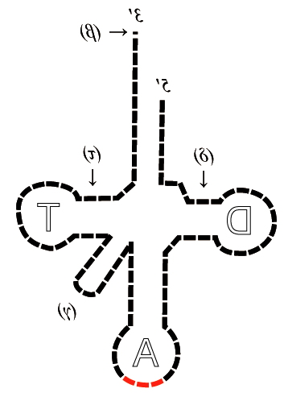
Translation
Messenger RNA (mRNA) carries the nucleotide code for the protein to be made.
Amino Acid
Transfer RNA (tRNA) molecules “interpret” the nucleotide code.
5′
Each tRNA carries an amino acid and the anticodon complementary to the codon in the mRNA.
tRNA
anticodon
AC
codon
UG
5′
3′
mRNA
Source: http://commons.wikimedia.org/wiki/File:Schema_ARNt_448_658.png

Slide 10
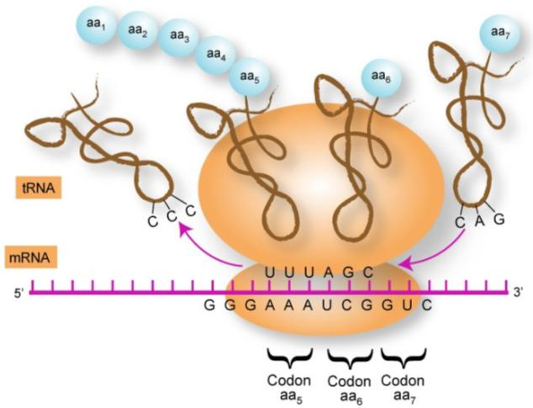
Translation
Ribosomes use tRNAs to “read” messenger RNA and assemble the amino acids they carry into a new protein.
DNA-Interactive: http://www.dnai.org/a/index.htmlDNA-Interactive: http://www.dnai.org/a/index.html or http://www.stolaf.edu/people/giannini/flashanimat/molgenetics/translation.swf
Source: http://commons.wikimedia.org/wiki/File:Proteintransl.jpg

Slide 11
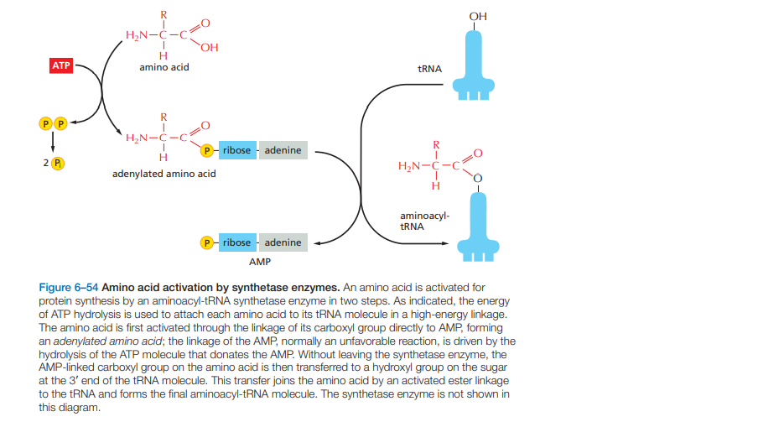

Slide 12
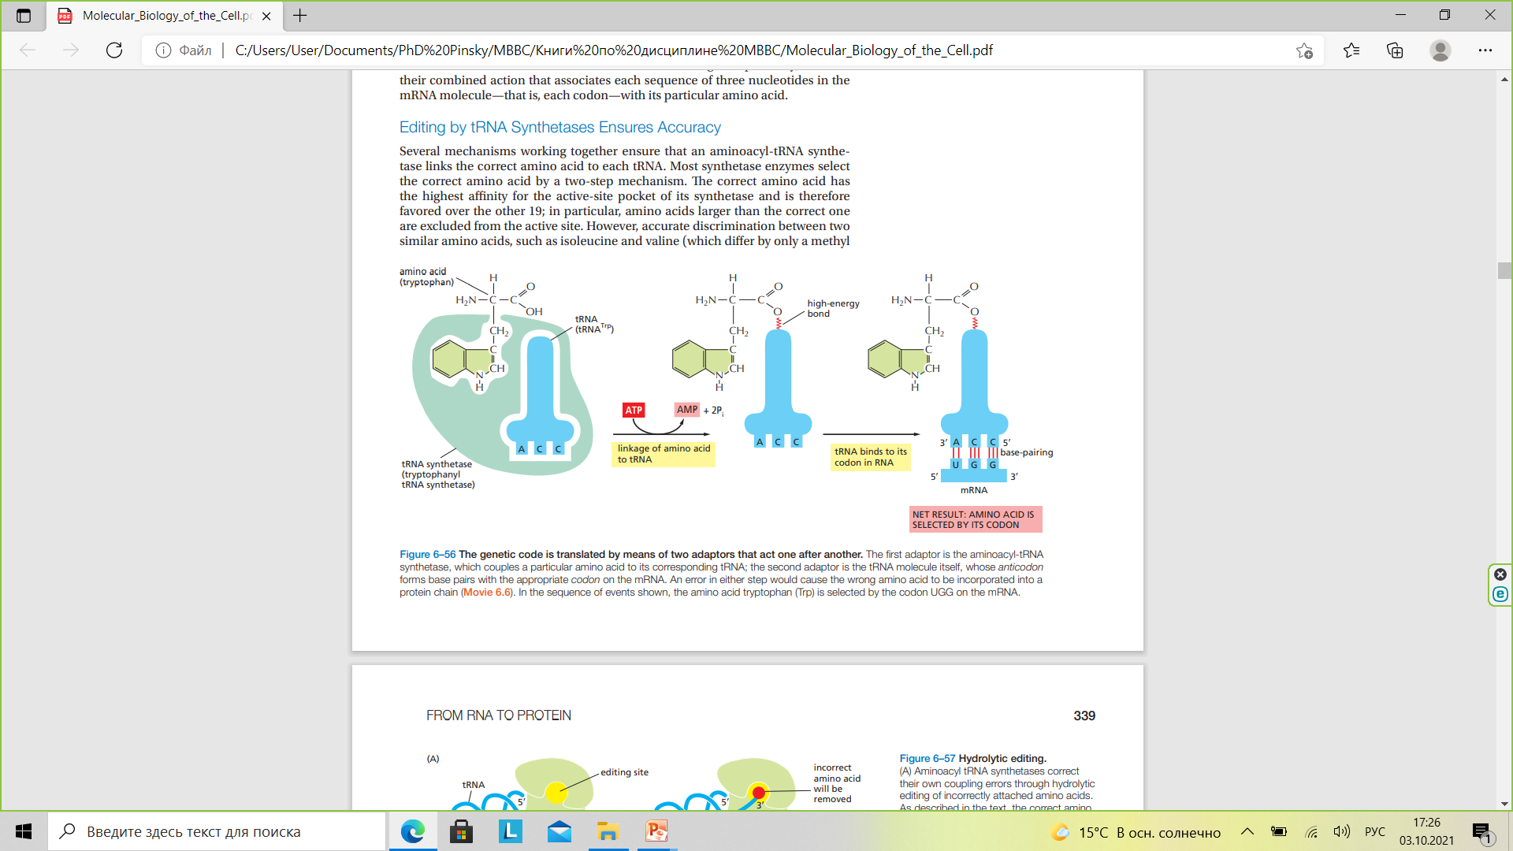

Slide 13
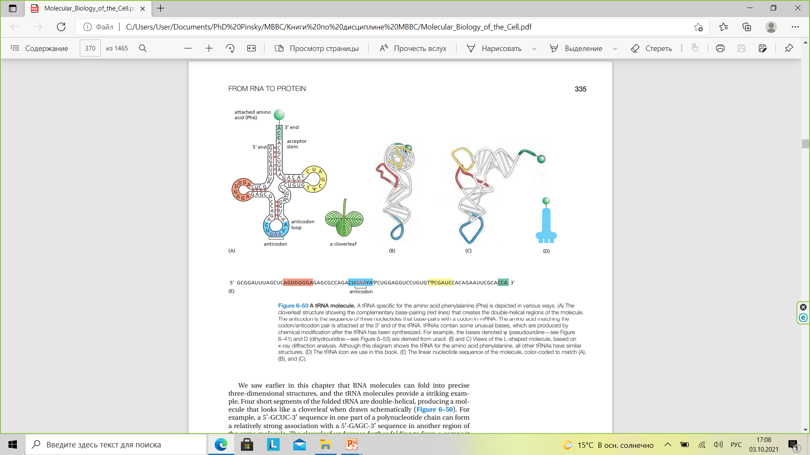

Slide 14
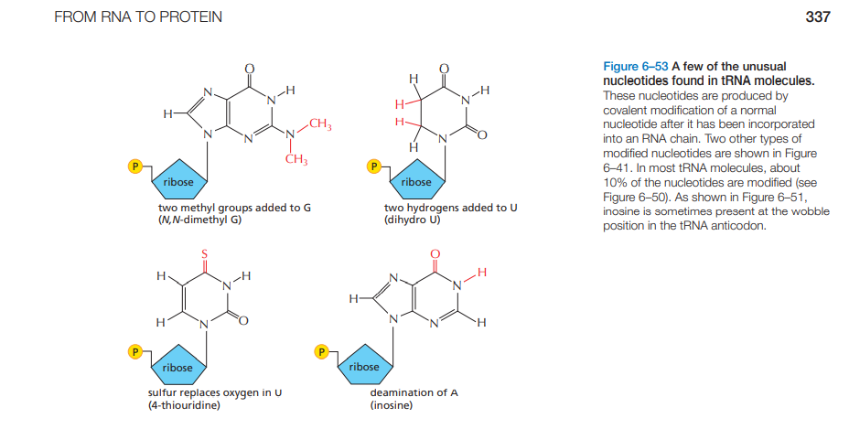

Slide 15
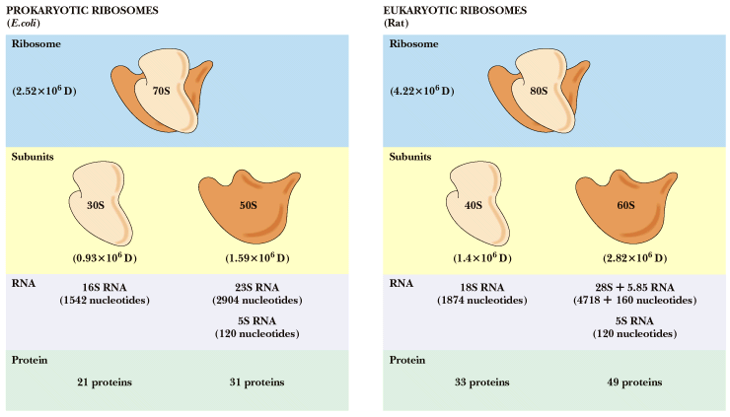
Ribosomes and ribosomal RNAs
Notes:
Eukaryotic mRNA
DNA is transcribed to produce heterogeneous nuclear RNA
mixed introns and exons with poly A
intron - intervening sequence
exon - coding sequence
poly A tail - stability?
Splicing produces final mRNA without introns
Ribosomal RNA
Ribosomes are about 2/3 RNA, 1/3 protein
rRNA serves as a scaffold for ribosomal proteins
23S rRNA in E. coli is the peptidyl transferase!

Slide 16
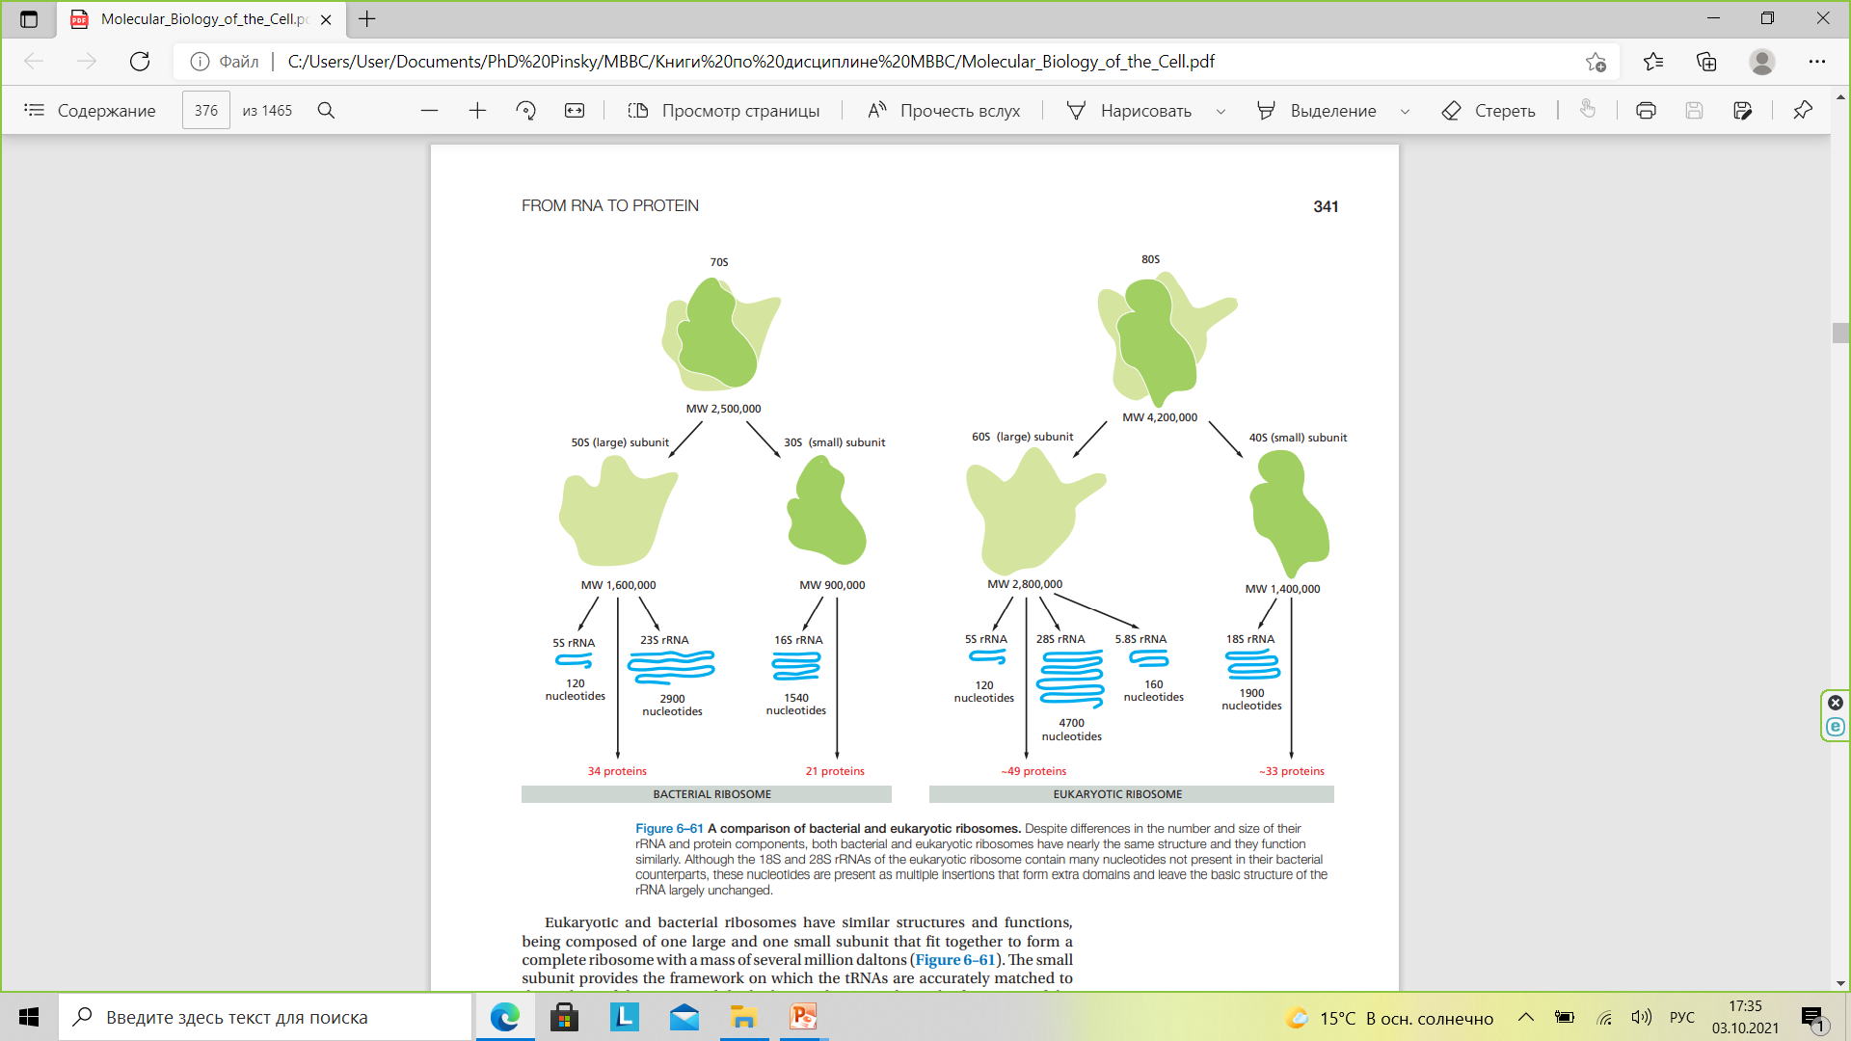

Slide 17
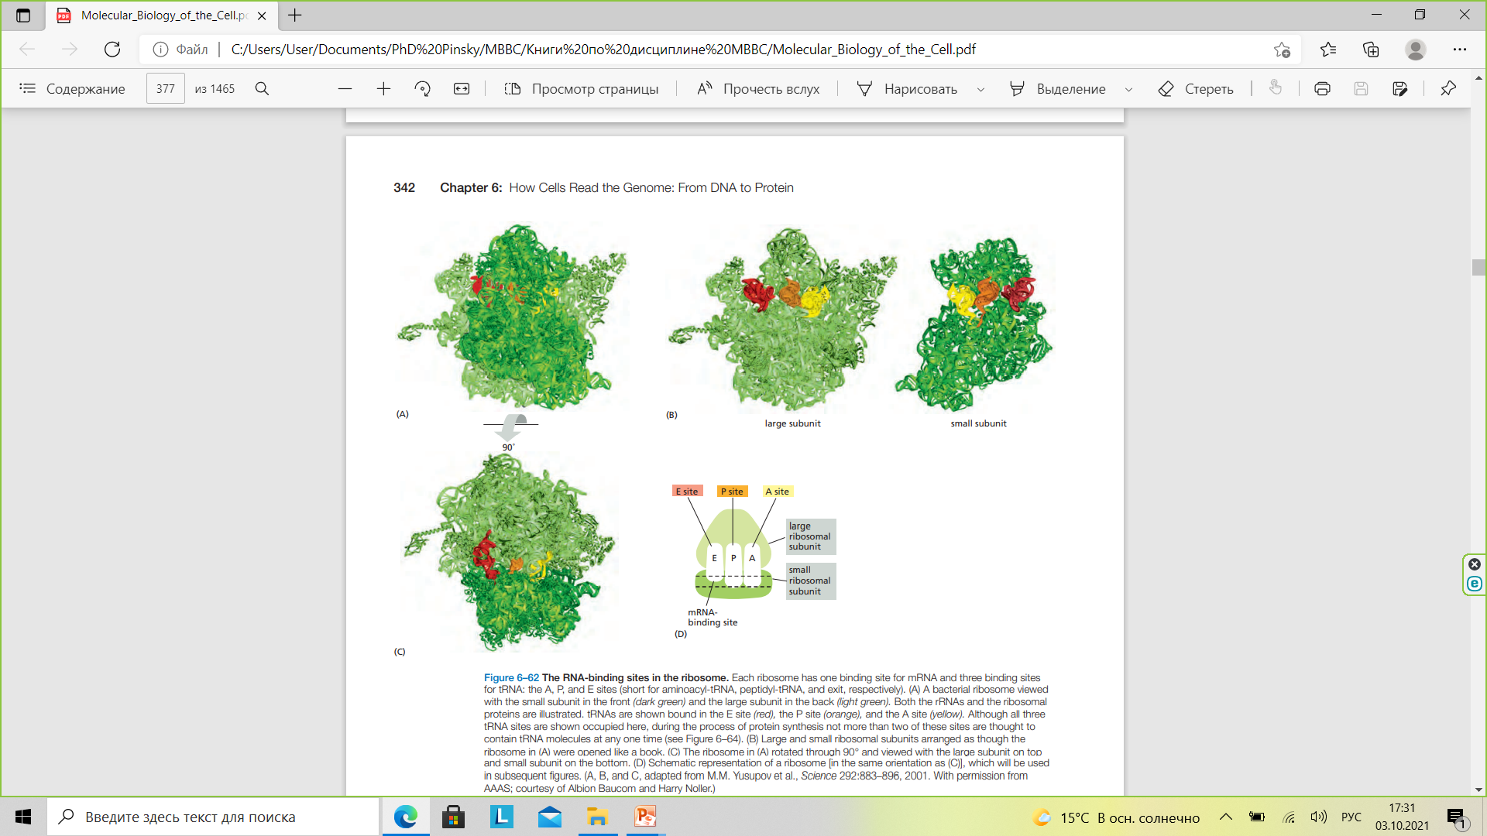

Slide 18
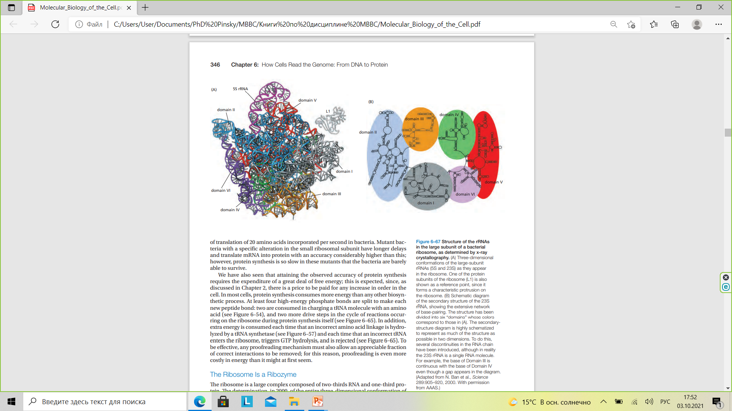

Slide 19
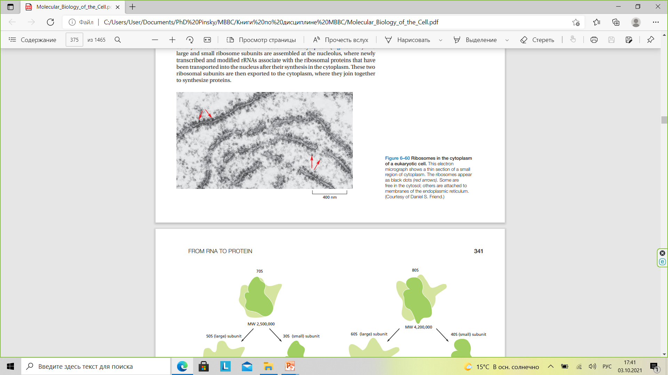

Slide 20
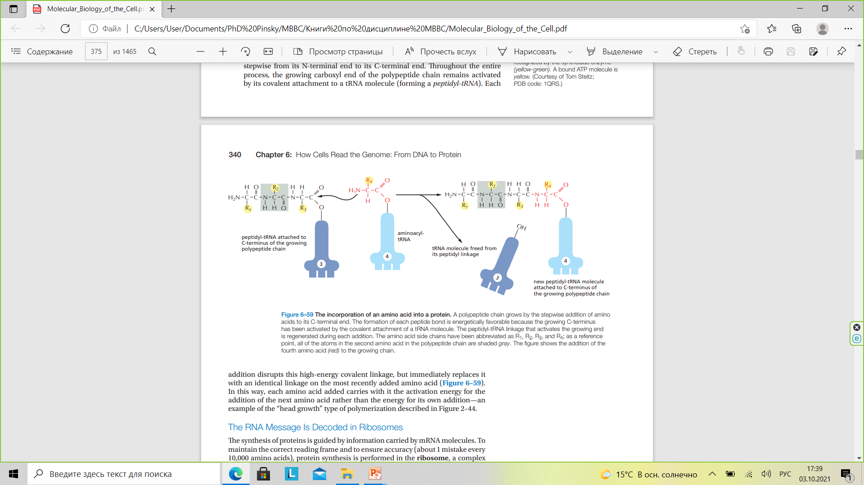

Slide 21
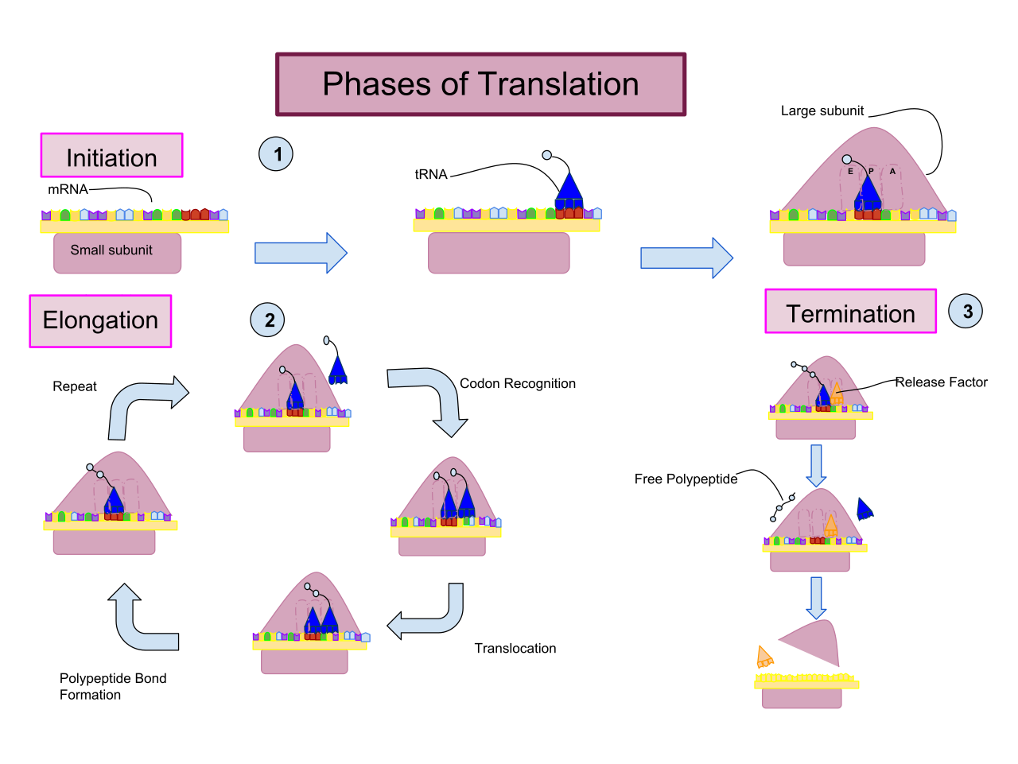
By Carihuer - Own work, CC BY-SA 4.0, https://commons.wikimedia.org/w/index.php?curid=69627732

Slide 22
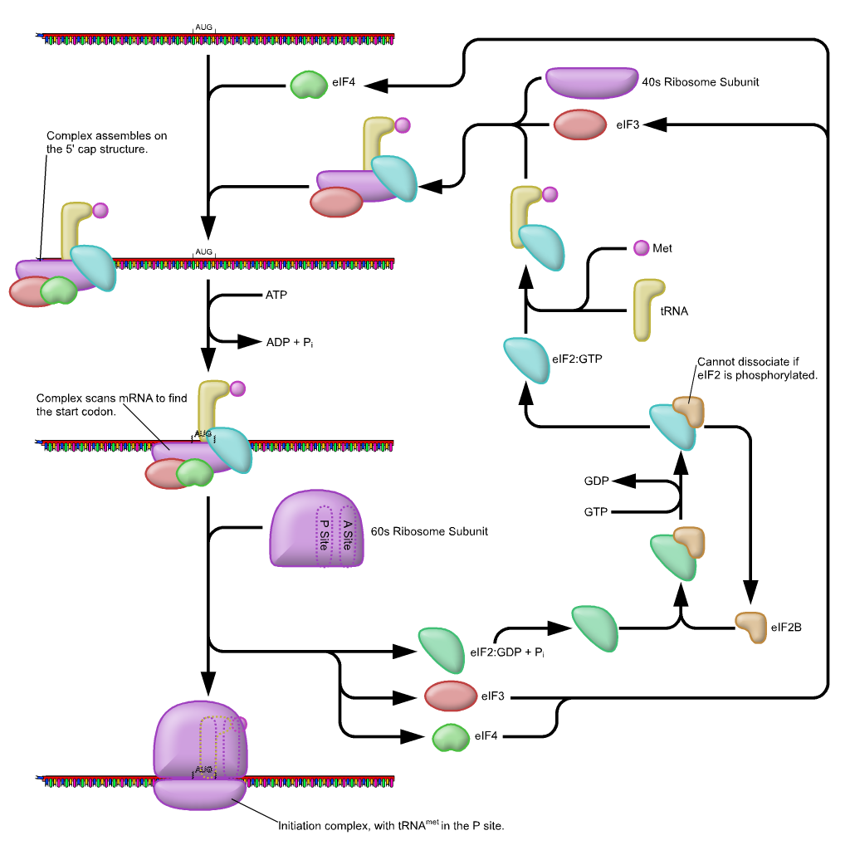
By Richard Wheeler (Zephyris) 2005; The process of initiation of translation in eukaryotes.

Slide 23
